Slide 1
IoT for Smart Buildings:
Energy Management System
RU EMS: Rowan University Energy Management Systems
Authors: Kevin Bellomo-Whitten, Eric Guidarelli,
Jeff Welder, Tomas Stoudt (consultant)
Date: December 9th, 2015
ECE 09.402
Introduction to Smart Buildings
Dept. of ECE
Henry M. Rowan College of Engineering
Rowan University

Slide 2
Outline
3
7
10
15
17
Introduction and
Application
Requirements and
Solution Architecture
Software and
Hardware Design
Functional V&V
Conclusions
Benefits of a Smart Building Architecture
Utilize Smart Building Benefits
Smart Energy Management System
Project Requirements
Analysis of Project Requirements
Project Schematic: Block Diagram
Software Architecture: Top Level
Software Architecture: Send/Receive Data
Software Architecture: ADC on the Pi
Results Comparison
Future Work and Conclusions

Slide 3
Introduction and Application

Slide 4



Benefits of a Smart Building Architecture
Renewable Energy
User Independence
Utility Benefits
Adding a renewable energy source can supplement a buildings electrical loads
End user can draw power from their renewable technologies, or export energy to the grid for cost savings
More local resources to draw power from to help stabilize their grid

Slide 5
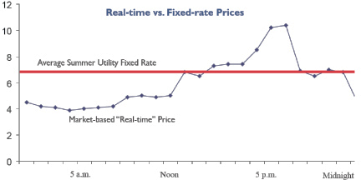

Utilize Smart Building Benefits
Real-Time Pricing
Having alternative energy sources to pull from during the grids peak pricing times can lower total energy costs
http://www.citizensutilityboard.org/images/rtp_comed2.jpg

Slide 6

Smart Energy Management System
Monitor Grid
Set Preferences
Smart Responses
Gather relevant data from the grid like time-based energy rates, cloud coverage, and sunrise/sunset times
Create rules that determine where to take power from or when to sell energy back to the grid based on gathered data
Change the source of energy for system

Slide 7
Requirements and Solution Architecture

Slide 8
Project Requirements
Monitoring System
Simulate a micro grid over a one day time-span
  Utility power
  Renewable energy source
  Energy storage unit
  Monitoring system
Generate mock input data for monitoring system
Communicate between monitoring system the simulation
To fit the project in the constraints of a one-semester timeframe, only the monitoring portion of the system was made

Slide 9


Analysis of Requirements
Simulation Type
Monitoring System
Communication
MathWorks has a toolbox for the SimuLink program that has power grid components
A Raspberry Pi was chosen as the monitoring system that would gather the mock relevant data
The simulation and monitoring system should communicate over wireless User Datagram Protocol (UDP)

Slide 10
Software and Hardware Design

Slide 11
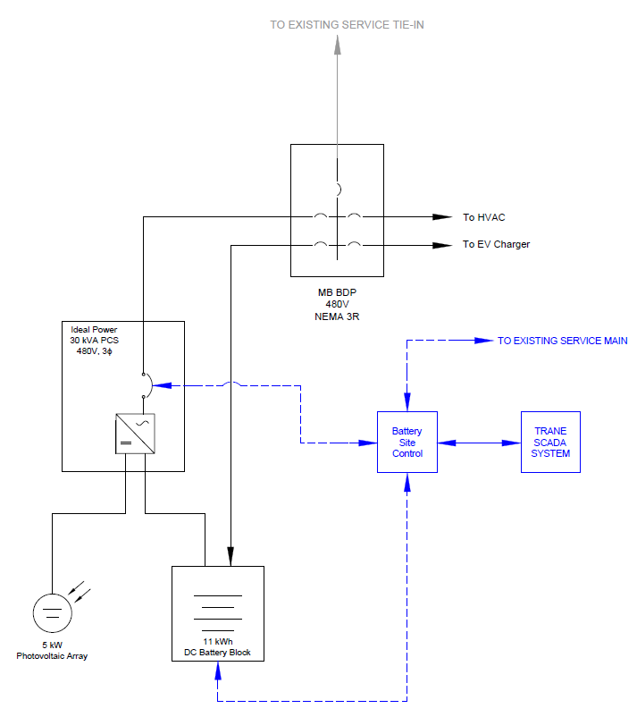
Project Schematic
Block Diagram
A set of loads tied to an existing service, battery block, PV array, and management system are shown in this schematic

Slide 12
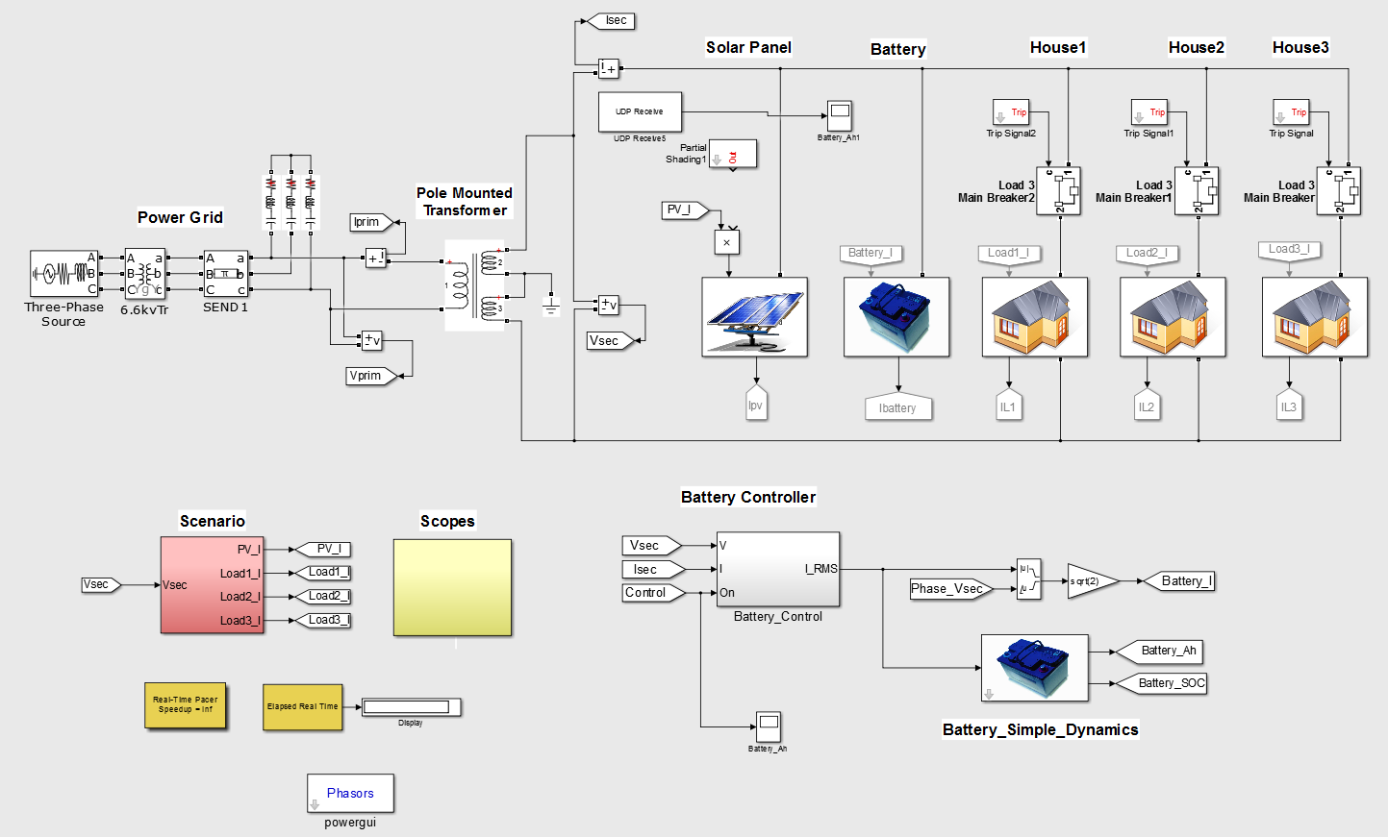
Software Architecture: Top Level

Slide 13
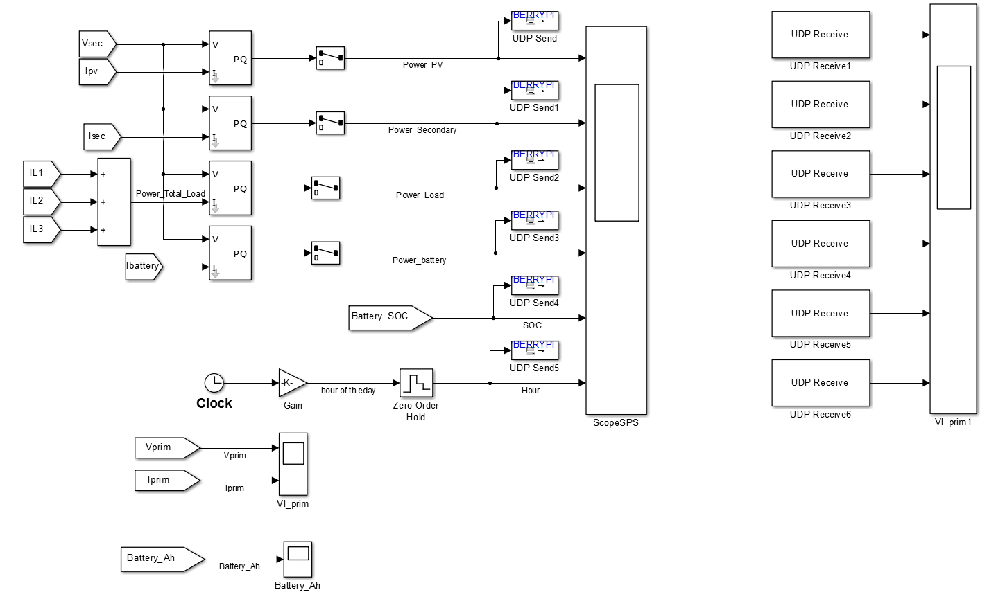
Software Architecture: Send/Receive Data

Slide 14
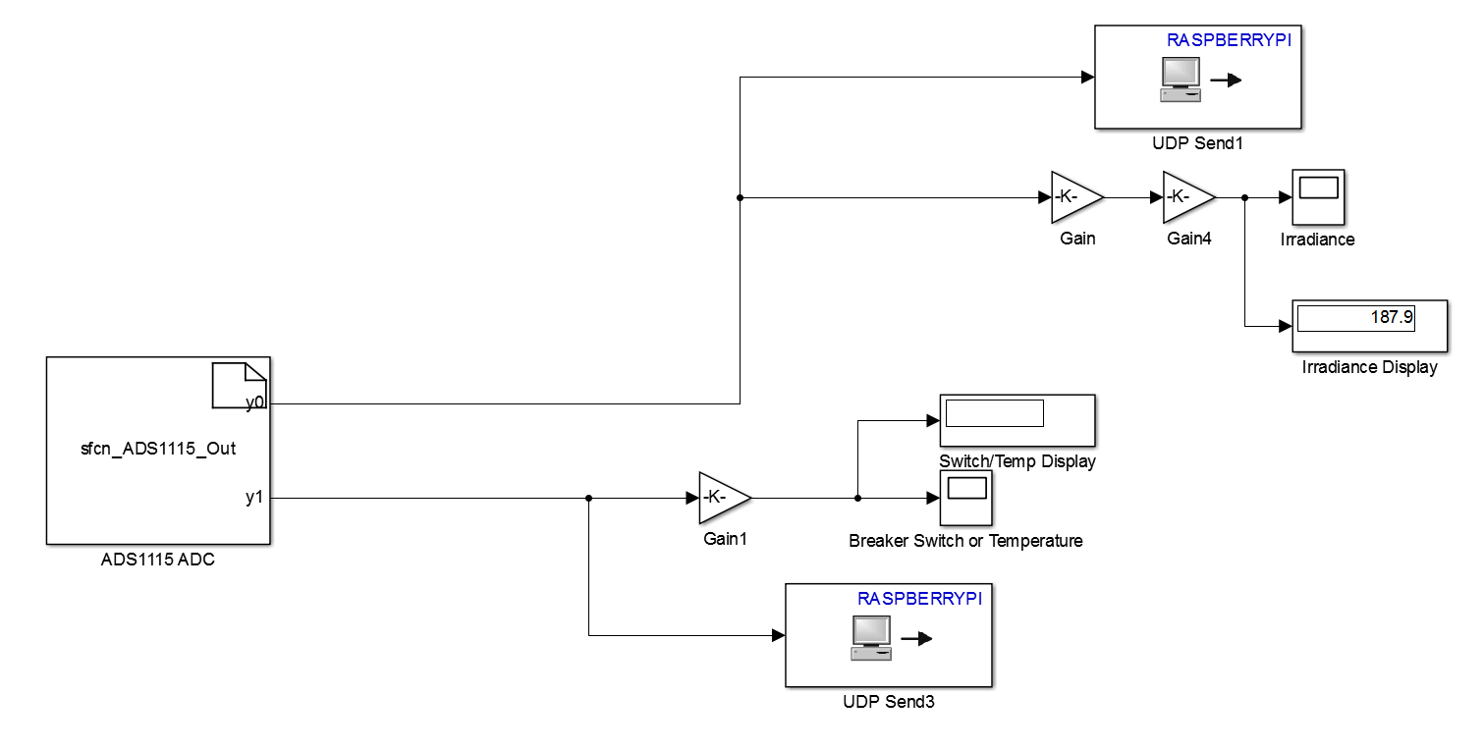
Software Architecture: ADC on the Pi

Slide 15
Functional V&V

Slide 16
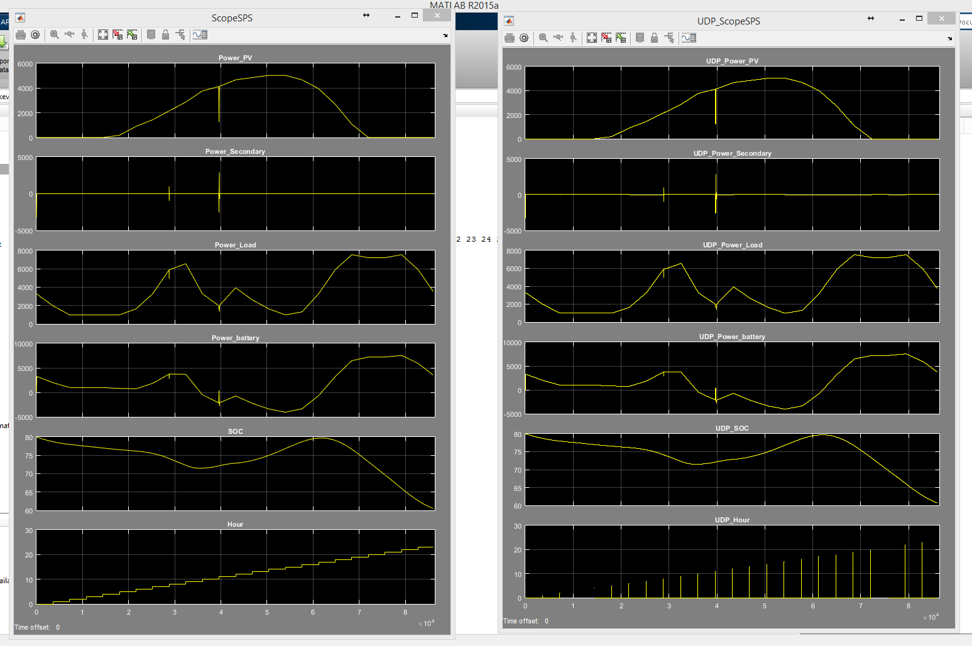
Results Comparison

Slide 17
Conclusions

Slide 18
Future Work and Conclusion
Energy Storage
Weather API
Conclusion
Built-in energy storage blocks in Simulink did not realistically simulate storing energy
Including free weather APIs that could provide information on cloud coverage, reducing PV arrays effectiveness
Two working components, but issues communicating between live sensor UDP and simulation UDP kept them separate

Slide 19
Questions?

